Slide 1
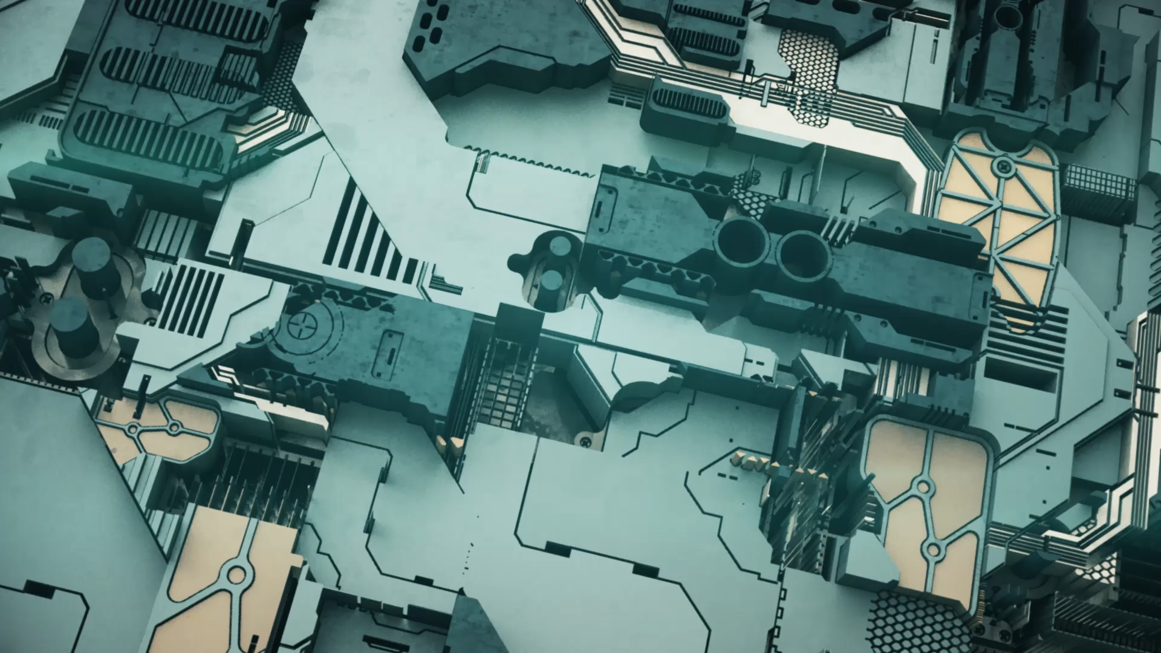
ALL ABOUT THE ROBOTIC HARDWARE (3-CONTROLLER)
1. Artificial Intelligence Machine Automation Controller
2. T20 Pendant.
3. Fanless Embedded Computer

Slide 2
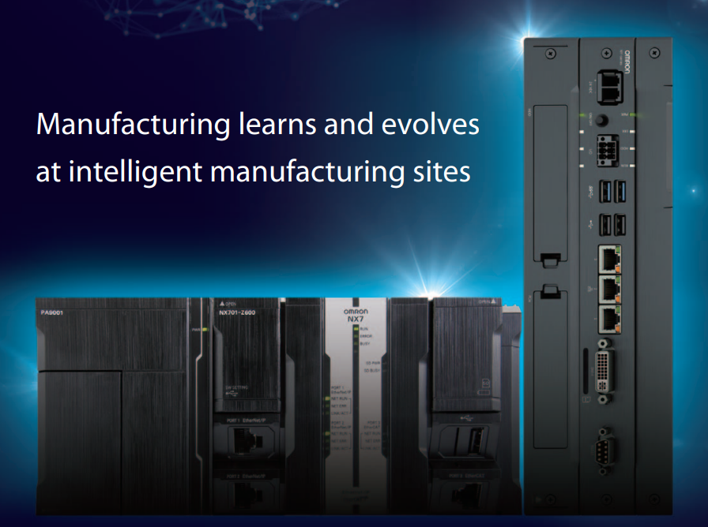
Artificial Intelligence Machine Automation Controller (Edge AI Controller) by Omron
Incorporates AI capabilities into control, allowing you to exploit machine data in real time.
Can detect equipment irregularities fast and correctly, and send back to control in real time. This allows for machine-level trend monitoring as well.
Prevents quality faults from occurring on high-speed production lines in a short period of time.

Slide 3
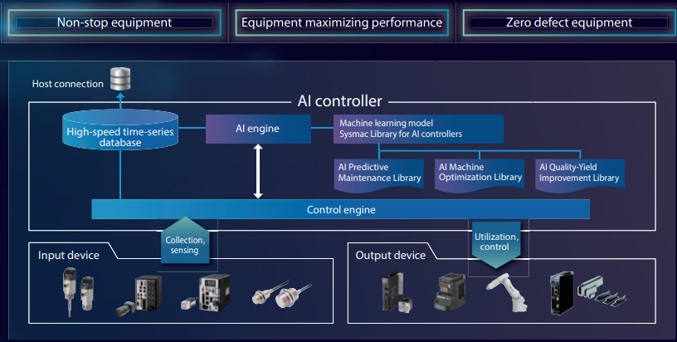
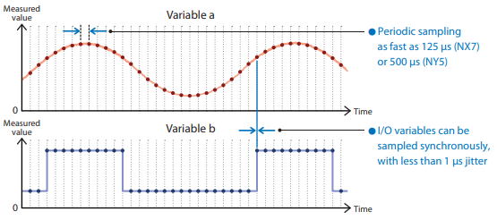
The unique data utilization functionality to provide ultimate edge control makes previously invisible machine status visible, which enables the AI controller to detect strange behavior of machines at the microsecond level.
Functions to detect quickly and accurately
Data utilization to detect strange behavior
Ultra-high-speed AI engine
accurate detection of strange behavior

Slide 4
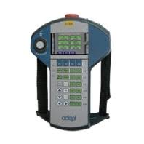
T20 Pendant by Omron

Slide 5
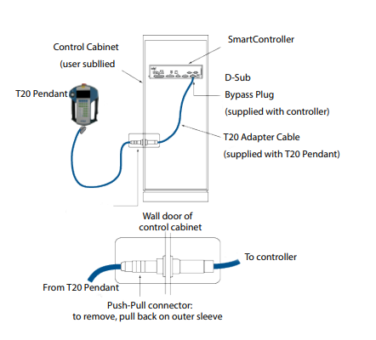
Used to control robot manually
provides an ergonomic and durable package with which users can manually teach a robot.
extremely compact, lightweight device, which can be operated with one hand. This means that the other is constantly available for process support activities.
It is designed for right-handed and left-handed use.

Slide 6
Features
Dual Channel Circuit Emergency Stop Switch
(1) 3-Position Enabling Switch
Compatibility with Adept SmartController EX Systems

Slide 7
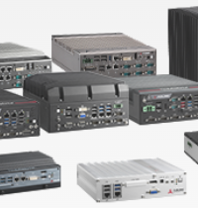
Matrix Fanless Embedded Computer (Industrial PC) by ADLink
Enhances responsiveness and durability of edge AI and edge computing applications. Designed to perform and to last, the Matrix fanless embedded computers enable timely data-driven decision making at the edge, improving efficiency, productivity and security enhancement across industries.
The applications of the Matrix fanless embedded computers include accelerated compute-intensive, high-resolution medical imaging for faster diagnosis, defect detection and classification for quality assurance, facial recognition at entry points for access control, worker movement tracking for hazard prevention and control, and more.

Slide 8
Features
Feature the latest Intel® Xeon®, Core™ and Atom® processors
Integrated GPU computing with NVIDIA® Quadro® GPUs
Support precise motion control, protocol-based devices, and application-specific hardware-accelerated processing
Offer a comprehensive I/O set to interface with auxiliary devices
Deliver reliable operation in poor ventilation, limited space, temperature extremes, dust-prone and corrosive conditions

